Slide 1

Core Java
#THEKAMALNAIN
@THEKAMALNAIN

Slide 2
What is Java
Java is a programming language and Java is a platform.
Java is a high level,
object-oriented,
N
secure programming language.

Slide 3
History of Java
Java was developed by Sun Microsystems (which is now the subsidiary of Oracle) in the year 1995.
Before Java, its name was Oak.
Since Oak was already a registered company, so James Gosling and his team changed the Oak name to Java.
James Gosling is known as the father of Java.
JDK Alpha and Beta (1995)
JDK 1.0 (23rd Jan 1996)
JDK 1.1 (19th Feb 1997)
J2SE 1.2 (8th Dec 1998)
J2SE 1.3 (8th May 2000)
J2SE 1.4 (6th Feb 2002)
J2SE 5.0 (30th Sep 2004)
Java SE 6 (11th Dec 2006)
Java SE 7 (28th July 2011)
Java SE 8 (18th Mar 2014)
Java SE 9 (21st Sep 2017)
Java SE 10 (20th Mar 2018)

Slide 4
Java Platforms / Editions
1) Java SE (Java Standard Edition)
2) Java EE (Java Enterprise Edition)
3) Java ME (Java Micro Edition)
4) JavaFX

Slide 5
Application by JAVA
Desktop Applications such as acrobat reader, media player, antivirus, etc.
Web Applications such as irctc.co.in.
Enterprise Applications such as banking applications.
Mobile
Embedded System
Smart Card
Robotics
Games, etc.

Slide 6
Types of Java Applications
1) Standalone Application
2) Web Application
3) Enterprise Application
4) Mobile Application

Slide 7
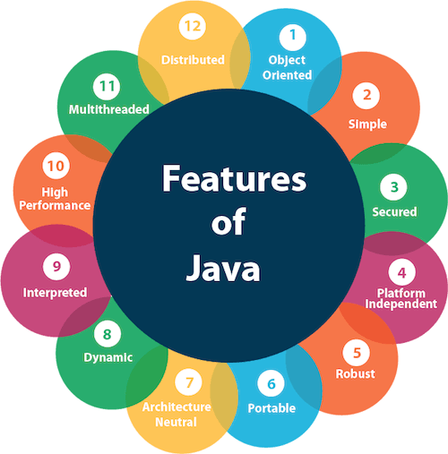

Slide 8
Comparison Index | C++ | Java
Platform-independent | C++ is platform-dependent. | Java is platform-independent.
Mainly used for | C++ is mainly used for system programming. | Java is mainly used for application programming. It is widely used in window, web-based, enterprise and mobile applications.
Design Goal | C++ was designed for systems and applications programming. It was an extension of C programming language. | Java was designed and created as an interpreter for printing systems but later extended as a support network computing. It was designed with a goal of being easy to use and accessible to a broader audience.
Goto | C++ supports the goto statement. | Java doesn't support the goto statement.
Multiple inheritance | C++ supports multiple inheritance. | Java doesn't support multiple inheritance through class. It can be achieved by interfaces in java.
Operator Overloading | C++ supports operator overloading. | Java doesn't support operator overloading.
Pointers | C++ supports pointers. You can write pointer program in C++. | Java supports pointer internally. However, you can't write the pointer program in java. It means java has restricted pointer support in java.
Compiler and Interpreter | C++ uses compiler only. C++ is compiled and run using the compiler which converts source code into machine code so, C++ is platform dependent. | Java uses compiler and interpreter both. Java source code is converted into bytecode at compilation time. The interpreter executes this bytecode at runtime and produces output. Java is interpreted that is why it is platform independent.
Call by Value and Call by reference | C++ supports both call by value and call by reference. | Java supports call by value only. There is no call by reference in java.
Structure and Union | C++ supports structures and unions. | Java doesn't support structures and unions.
Thread Support | C++ doesn't have built-in support for threads. It relies on third-party libraries for thread support. | Java has built-in thread support.
Documentation comment | C++ doesn't support documentation comment. | Java supports documentation comment (/** ... */) to create documentation for java source code.
Virtual Keyword | C++ supports virtual keyword so that we can decide whether or not override a function. | Java has no virtual keyword. We can override all non-static methods by default. In other words, non-static methods are virtual by default.
unsigned right shift >>> | C++ doesn't support >>> operator. | Java supports unsigned right shift >>> operator that fills zero at the top for the negative numbers. For positive numbers, it works same like >> operator.
Inheritance Tree | C++ creates a new inheritance tree always. | Java uses a single inheritance tree always because all classes are the child of Object class in java. The object class is the root of the inheritance tree in java.
Hardware | C++ is nearer to hardware. | Java is not so interactive with hardware.
Object-oriented | C++ is an object-oriented language. However, in C language, single root hierarchy is not possible. | Java is also an object-oriented language. However, everything (except fundamental types) is an object in Java. It is a single root hierarchy as everything gets derived from java.lang.Object.

